Slide 1

Clustering: Anomaly Detection with Local Outlier Factor
DS 5230-Summer 2020
Joshua Galloway

Slide 2
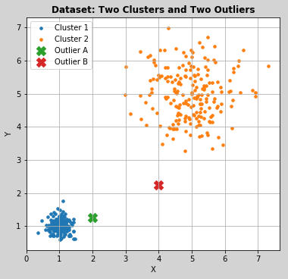
Overview (Slide 1)
Anomaly/Outlier Detection [3]
Problem: The main objective of a clustering algorithm is to find clusters, and not to optimize outlier detection due to being more globally perceptive.
Local Outlier Factor (LOF) [1]
LOF is a density-based algorithm, like DBSCAN or OPTICS, which is able to adjust for local variations in dataset density.
A distance-based system would have trouble finding ‘Outlier A’ in the graphic due to relative proximity issues.
Similarly, Centroid and Distribution Methods are likely to include the outliers as part of a nearby cluster.
Outlier (Hawkins-Outlier) [4]
An outlier is an observation that deviates so much from other observations as to arouse suspicion that it was generated by a different mechanism.
Applications [2]
Data Cleaning
Intrusion Detection Systems
Fraud Detection Systems
Novelty Detection

Slide 3
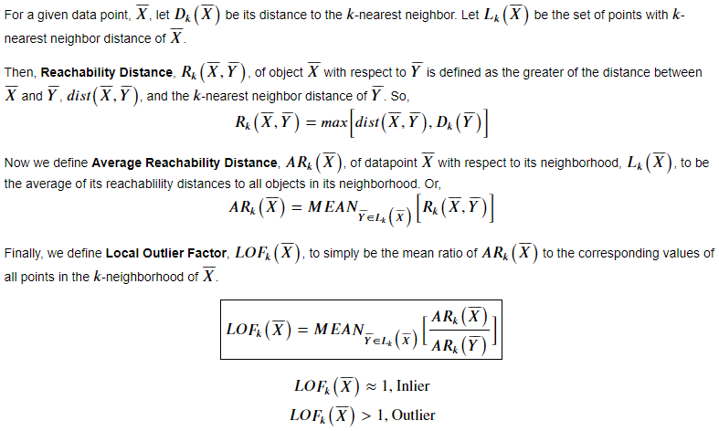
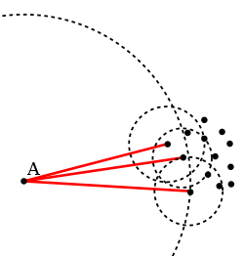
Model Development (Slide 2)
Basic Idea: Compare local density of a point with the densities of its k-nearest neighbors. Points with a lower density are outliers [2]
[1]
Point ‘A’ has a lower local density than that of its k neighbors and is thus an outlier as intuition would suggest. [2]

Slide 4
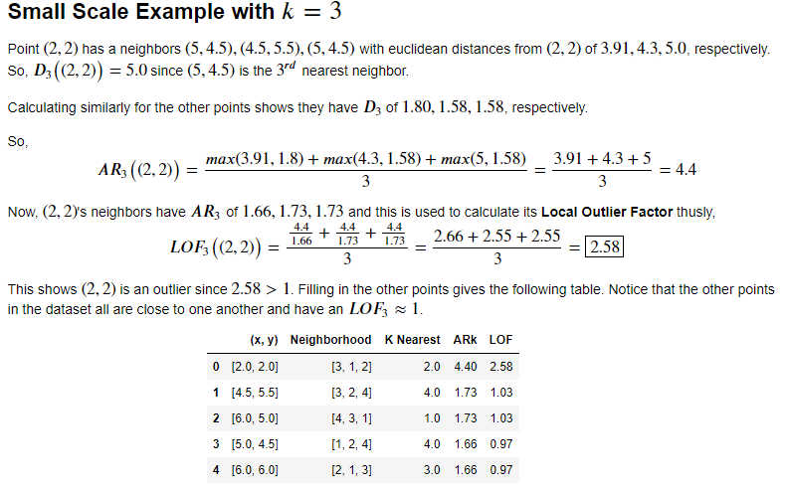
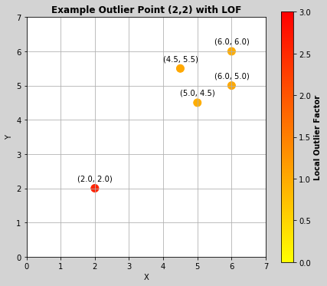
Local Outlier Factor Algorithm (Slide 3)

Slide 5
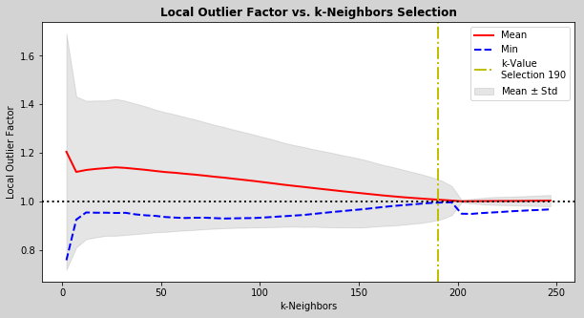
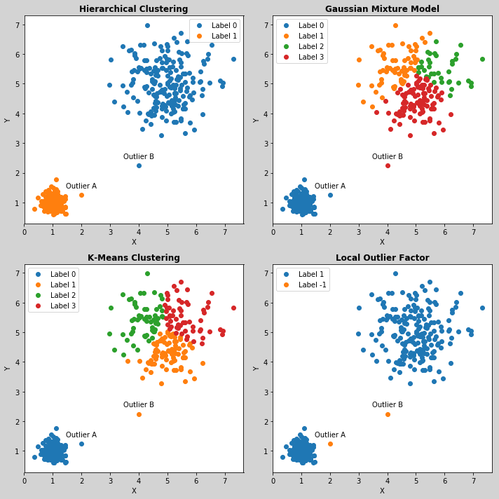
Local Outlier Factor Algorithm (Slide 4)
Applying To Our Original Dataset
The data set is comprised of two clusters and two outliers.
LOF Hyperparameter Tuning [3]
K-Neighbors is the main tuning parameter.
Selection of k can be regarded as the Minimum Number of Points a cluster must contain.
Plot the Mean, Minimum, and Standard Deviation of LOF vs k and the point at which the Minimum and Mean converge to 1 is the approximate value best suited for k.
Comparing Results
Standard hyperparameter selection methods applied to Hierarchical, Gaussian Mixture Model (GMM) and K-Means Algorithms were Applied
Distance-based clustering, Hierarchical, simply includes the outliers as part of the two clusters.
Distribution-based clustering, GMM, and Centroid-based clustering, K-Means, found erroneous extra clusters and included the outliers.
LOF is uniquely designed to find the outliers and so does even with ‘Outlier A’ being relatively close to the adjoining cluster.

Slide 6
Summary (Slide 5)
Anomaly/Outlier Detection [3]
LOF fills a gap left by other clustering methods for outlier detection.
LOF takes into account the local density of each point and assigns a continuous value indicating the degree to which each point is an outlier.
LOF Algorithm[1]
Given k, Computer the Reachability Distance to the point’s k-neighbors and take the average of that set to get the Average Reachability Distance
Take the ratio of the point’s average reachability distance to that of all its k-neighbors and average this set to obtain the Local Outlier Factor
Points with an LOF near unity are in a cluster, and points with LOF higher than unity are outliers.
Strengths [2]
Due to the local approach, LOF is able to identify outliers in a data set that would not be outliers in another area of the data set.
Weaknesses
Threshold of LOF for being an outlier may vary depending on dataset [2]
Algorithm is susceptible to the Curse of Dimensionality [5]
Recommended Further Reading
References 1, 3, and 5

Slide 7
References
Aggarwal, C. C. (2013). Chapter 4: Proximity-Based Outlier Detection. In Outlier Analysis (pp. 117-131). New York, NY: Springer.
Local outlier factor. (2020, May 22). Retrieved August 12, 2020, from https://en.wikipedia.org/wiki/Local_outlier_factor
Breunig, M., & Kreigel, H. (2000). LOF: Identifying Density-based Local Outliers. In Proceedings of the 2000 ACM SIGMOD International Conference on Management of Data: 2000, Dallas, Texas, United States, May 15- 8, 2000 (pp. 93-104). New York, NY: Association for Computing Machinery.
Hawkins, D.: “Identification of Outliers”, Chapman and Hall, London, 1980.
Zimek, A., Schubert, E., & Kriegel, H. (2012). A survey on unsupervised outlier detection in high-dimensional numerical data. Statistical Analysis and Data Mining, 5(5), 363-387. doi:10.1002/sam.11161

